Slide 1

Manufacturing Analytics
PCA‑Based Manufacturing Analytics Dashboard for an Automated Filling Line

Slide 2

Scope
The Problem: Monitoring a high-speed automated filling line for a new machine where traditional univariate limits might miss complex mechanical failures.
The Objective: Implement Principal Component Analysis (PCA) to detect multi-variable anomalies in real-time.
Analysis : 7,828 total parts produced between December 17 and December 18, 2025.

Slide 3
Data Preprocessing and Feature Engineering
Dimensionality Reduction: Captured 82% of process variance using only the first two components (PC1 and PC2).
PC1 (Sealing Integrity): Strongly influenced by total collapse, weld force, and weld time.
PC2 (Filling Precision): Primarily driven by tare weight and gross weight.
Hotelling’s T2 (exceeding 3000) signals a systematic shift
Q-residuals (reaching >200) indicates a mechanical glitch.

Slide 4
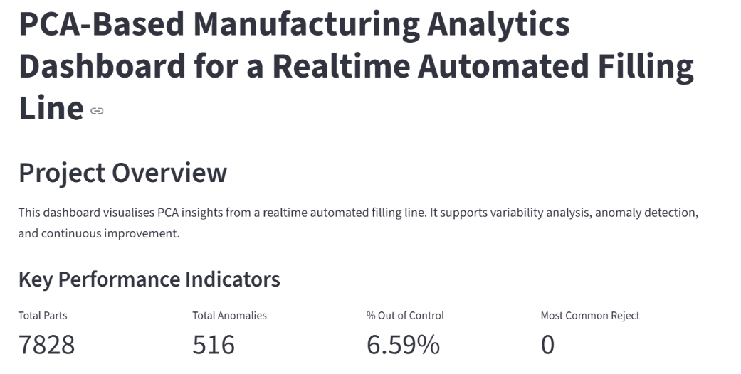
Findings
Anomaly Rate: Identified an overall 6.59% Out of Control rate (516 parts).

Slide 5
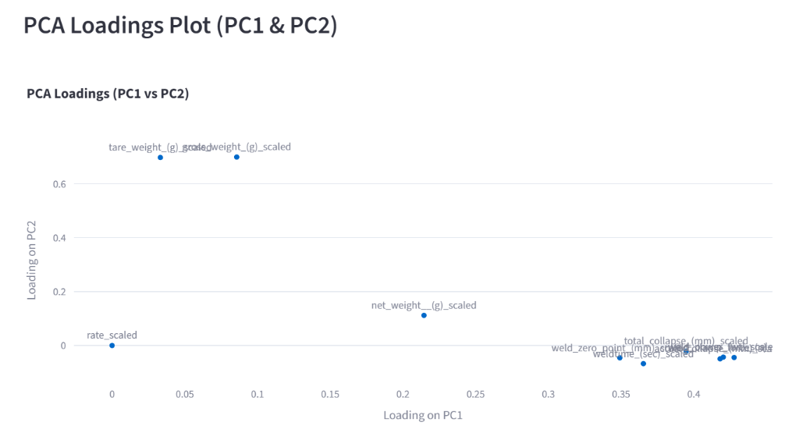
PCA Loadings
The "Normal" Baseline: The scores plot shows two distinct clusters of healthy operation, suggesting either two filling heads or two stable batch runs.
The Failure Signature: High-risk anomalies (Cluster 1) show a specific drift toward negative PC1, indicating that sealing mechanicals are the primary source of failure rather than fill-weights.

Slide 6
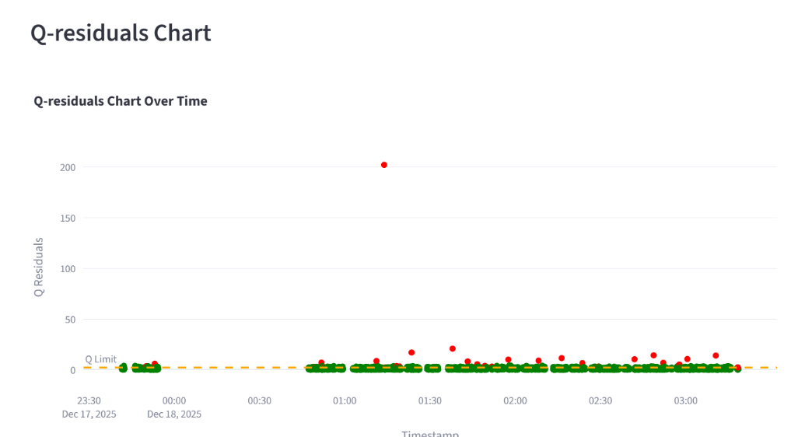
Real-Time Event Analysis (December 18)
01:15 : Mechanical Glitch: A massive spike in Q-residuals (reaching >200) indicates a "model-breaking" event, likely a momentary mechanical jam or sensor interference.

Slide 7
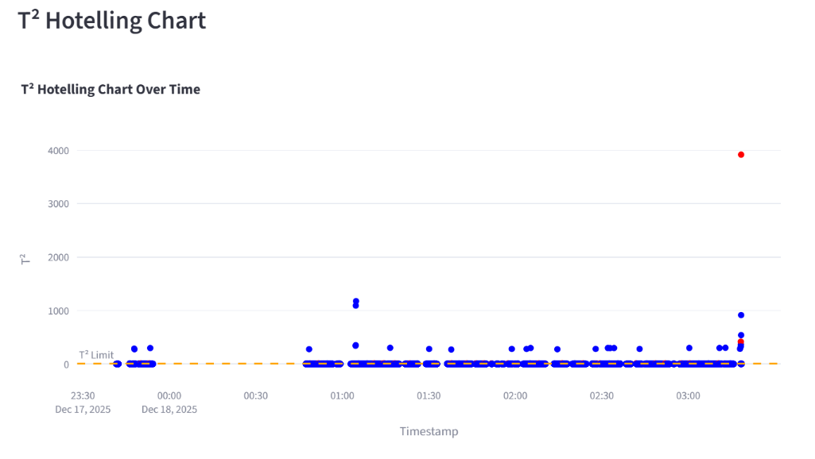
Real-Time Event Analysis (December 18)
03:00 : Process Shift: A sustained jump in Hotelling’s T2 (exceeding 3000) signals a systematic shift in the process mean, typical of an incorrect set-point change or calibration drift.

Slide 8

Conclusions and recommendations
New Machine Performance: The machine is capable of high precision but is currently experiencing "infant mortality" style glitches (Q-spikes) and calibration instability T2 shifts.
01
Action Plan:
02
Inspect sealing head alignment to reduce the PC1 drift.
Set automated alerts on the dashboard for T2 values exceeding 500 to catch batch errors early.
Future Work: Integrate the dashboard with the machine PLC for automated shutdown when Q-residuals spike.
03

